Slide 1

Farming Made Easy using Machine Learning
CVR COLLEGE OF ENGINEERING
DEPARTMENT OF INFORMATION TECHNOLOGY
MINI PROJECT SEMINAR
Project Guide: Mrs. Swathi Agarwal(Assistant Professor)
Team Members:
Ch. Indra Nehna(19B81A12D2)
K.Manasvini(19B81A12D4)
K.Srinija(19B81A12G6)

Slide 2
ABSTARCT
India being a rural nation, its economy transcendently relies upon agricultural yield development and unified agroindustry items. It is currently quickly advancing towards a specialized turn of events. India now is rapidly progressing towards technical development. Smart farming is changing the face of agriculture in India. Agriculture is the primary mainstay of the economy in our country. In recent years because of uncertain trends in climate and other fluctuations in the price trends, the price of the crop has varied to a larger level. Farmers remain oblivious of the uncertainties, which spoils the crops and causes massive loss. They are unaware of the crop price which would benefit them more. This application designed is handy, easy-to-use which provides accurate results in predicting the price of the crop. This framework utilizes Machine Learning’s Decision Tree Regression Algorithm to predict crop price. The attributes considered for prediction are rainfall, wholesale price index, month, and year. Consequently, the system gives an advance forecast to the farmers which grows the speed of profit to them and consequently the country's economy. This system also incorporates other attributes like weather forecast, crop recommendation are also implemented.

Slide 3
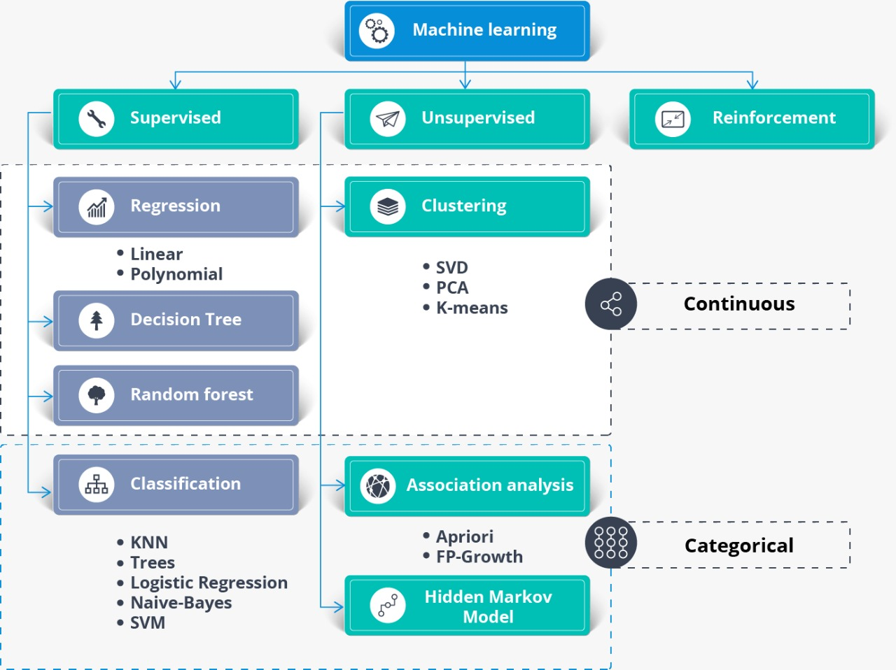
INTRODUCTION
Machine Learning is subfield of Artificial Intelligence. It has the capability of a machine to imitate intelligent human behavior.

Slide 4
LITERATURE REVIEW
Rachana, Rashmi, Shravani, Shruthi, Seema Kousar, Crop Price Forecasting System Using Supervised Machine Learning Algorithms, International Research Journal of Engineering and Technology (IRJET), Apr 2019.
In April 2019, the exploration targets foreseeing both the cost and benefit of the given harvest before planting.
The preparing datasets so acquired give enough bits of knowledge to foresee the suitable cost and request in the business sectors.
Nishiba Kabeer, Dr.Loganathan.D, Cowsalya.T, Prediction of Crop Yield Using Data Mining, International Journal of Computer Science and Network, June 2019 .
The expected utilization of data mining procedures in foreseeing the harvest yield dependent on the input parameters average rainfall and area of the field.
The easy-to-use website page created for anticipating crop yield can be utilized by any client by giving the normal precipitation and region of that place.

Slide 5
Gamage, A., & Kasthurirathna, D. Agro-Genius: Crop Prediction Using Machine Learning, International Journal of Innovative Science and Research Technology, Volume 4, Issue 10, October – 2019.
The best crop and its required fertilizers make the farmer more confident about the crop and its yield and also our system will do marketing work by estimating total value of the crop based on current market price.
The idea of the system can be extended by adding some extra features to the system like providing a nearby shop location portal for purchasing seeds and fertilizers.
Naveen Kumar P R, Manikanta K B, Venkatesh B Y, Naveen Kumar R, Amith Mali Patil, Journal of Xi'an University of Architecture & Technology, 2020.
This system is proposed to provide help to the farmers for expecting the best amount for their crops and for predicting the best price for the crops.
This also helps the farmers to check previous prices of different commodities.
The system can predict crops using [9] Random forest, Polynomial Regression and Decision Tree algorithms.

Slide 6
LIMITATION
The predictions that has been generated through this application are not 100% accurate as there would be a fluctuation in the factors like rainfall, crop quality and climatic conditions which play a major role in deciding the price of the yield and crop generated.

Slide 7
PROBLEM STATEMENT
Farmers plan for a crop based on factors like weather and climatic conditions, location of the land where it is situated. They lack proper knowledge about these factors which are essential to predict the price of a crop. Hence, looking at this problem we decided to help farmers by providing them with these factors in our application where they can easily access the data and find out the difference between the original price and predicted price of a crop. Linear Regression algorithm was used for this crop price prediction before, which resulted in less accuracy and less efficiency, as we wanted to develop a web application with more accuracy and more efficiency compared to previous one we used the KNN algorithm, Random Forest algorithm and Decision Tree algorithm.

Slide 8
MODULES AND ITS DESCRIPTION
New Farmer Signup:
Using this module farmers can signup with application.
Farmer Login:
Farmer can login to application by using username and password given at signup time and then farmer can select crop name to get its predicted prices in different market. Farmer can view all schemes details launched from the government.
Admin Login:
Admin can login to application by using ‘admin’ as username and password and then can add new schemes details.

Slide 9
MINIMUM CONFIGURATION OF HARDWARE AND SOFTWARE REQUIREMENTS
HARDWARE REQUIREMENTS:
System: i3 or Above.
Hard Disk: 40 GB.
RAM: 4 GB.
SOFTWARE REQUIREMENTS:
Python 3.7.0
MySQL 5.5
Django Framework 2.1.7
Windows 8 or Above Operating System
Python libraries:
NumPy
Pandas
Scikit-learn
Matplotlib

Slide 10
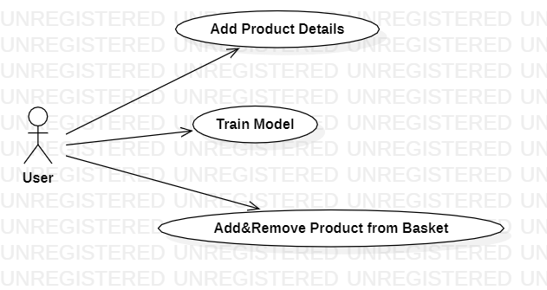
USE CASE DIAGRAM

Slide 11
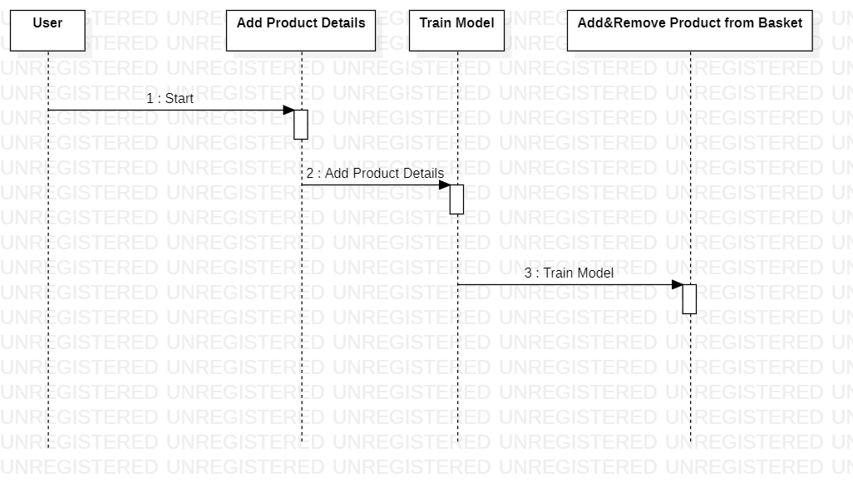
SEQUENCE DIAGRAM

Slide 12
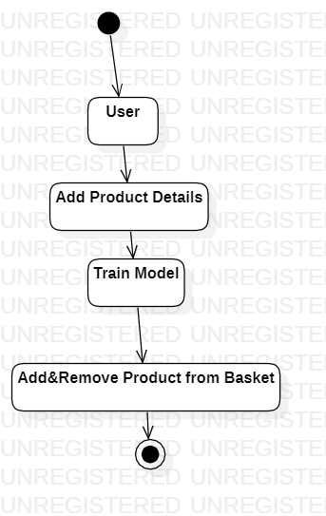
ACTIVITY DIAGRAM

Slide 13
ANALYSIS AND DESIGN
To implement the system, we decided to focus on historical data about the crop and the climate at the district level was needed to implement the system.
This data has been gathered from the government website www.data.gov.in
which includes State, District, Crop, Area and Production.
The data about the climate conditions suitable for the particular crops includes rainfall, arrival time, minimum and maximum price.

Slide 14
Exploratory Data Analysis: It refers to the critical process of performing initial investigations on data so as to discover patterns, to spot anomalies, to test hypotheses and to check assumptions with the help of summary statistics and graphical representations.
Data Cleaning: It is the process of preparing data for analysis by removing or modifying data that is incorrect, incomplete, irrelevant, duplicated, or improperly formatted.
Encoding: It is a required pre-processing step when working with categorical data for machine learning algorithms.
Feature Scaling: It is a technique to standardize the independent features present in the data in a fixed range. It is performed during the data pre-processing to handle highly varying magnitudes or values or units.
Data Partitioning: The Entire dataset is partitioned into 2 parts: for example, say, 75% of the dataset is used for training the model and 25% of the data is set aside to test the model.

Slide 15
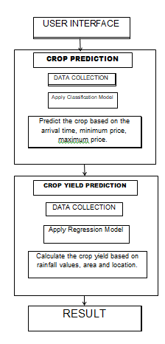
ARCHITECTURE
There are basically two categories:
Crop prediction -
It predicts the most appropriate crop based on arrival time, minimum price, maximum price.
Crop yield prediction -
It predicts the production of the crop based on area and location. The climate related data like rainfall values can be acquired through the dataset and crop type can be input through the user.

Slide 16
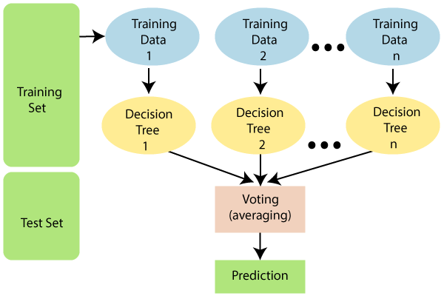
RANDOM FOREST ALGORITHM
Random forest is the supervised learning algorithm that can be used for both classification and regression problems in machine learning. It is an ensemble learning technique that provides the predictions by combining the multiple classifiers and improve the performance of the model.
It contains multiple decision trees for subsets of the given dataset, and find the average to improve the predictive accuracy of the model. A random-forest should contain 64-128 trees. The greater number of trees leads to higher accuracy of the algorithm.
To classify a new dataset or object, each tree gives the classification result and based on the majority votes, the algorithm predicts the final output.
Random forest is a fast algorithm, and can efficiently deal with the missing & incorrect data.

Slide 17
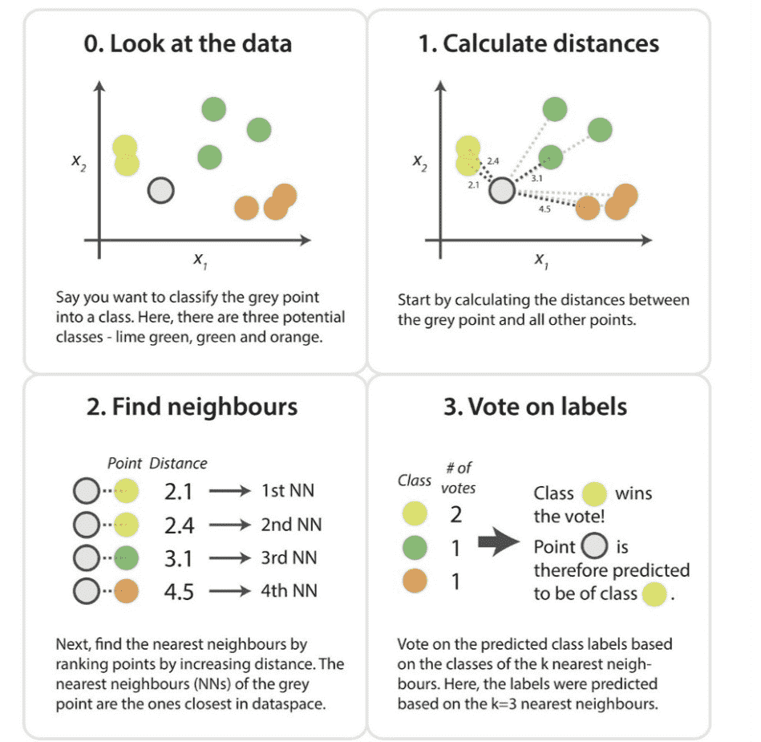
K-NEAREST NEIGHBOR ALGORTIHM(KNN)
K-Nearest Neighbor is a supervised learning algorithm that can be used for both classification and regression problems.
K-Nearest Neighbors stores all available cases and classifies new cases based on a similarity measure. It is a powerful classification algorithm used in pattern recognition.
This algorithm works by assuming the similarities between the new data point and available data points. Based on these similarities, the new data points are put in the most similar categories and any distance function measures the distance between the data points.
The distance function can be Euclidean distance based on the requirement .

Slide 18

DECISION TREE REGRESSION ALGORTIHM
A decision tree is a supervised learning algorithm that is mainly used to solve the classification problems but can also be used for solving the regression problems. It can work with both categorical variables and continuous variables. It shows a tree-like structure that includes nodes and branches, and starts with the root node that expand on further branches till the leaf node.
The internal node is used to represent the features of the dataset, branches show the decision rules, and leaf nodes represent the outcome of the problem.
Decision trees are powerful and popular tools for classification and prediction.
Decision trees represent rules, which can be understood by humans and used in knowledge system such as database.

Slide 19
Exploratory Data Analysis :
It refers to the critical process of performing initial investigations on data so as to discover patterns, to spot anomalies, to test hypotheses and to check assumptions with the help of summary statistics and graphical representations.
Following things are part of EDA :
- Get maximum insights from a data set
- Uncover underlying structure
- Extract important variables from the dataset
- Detect outliers and anomalies(if any)
- Test underlying assumptions
- Determine the optimal factor settings

Slide 20
Data Cleaning :
It is the process of preparing data for analysis by removing or modifying data that is incorrect, incomplete, irrelevant, duplicated, or improperly formatted.
Step 1: Remove duplicate or irrelevant observations
Step 2: Fix structural errors
Step 3: Filter unwanted outliers
Step 4: Handle missing data
Step 5: Validate
Data cleaning, also referred to as data cleansing and data scrubbing, is one of the most important steps for your organization if you want to create a culture around quality data decision-making.

Slide 21
Label Encoding:
It refers to converting the labels into a numeric form so as to convert them into the machine-readable form. Machine learning algorithms can then decide in a better way how those labels must be operated. It is an important pre-processing step for the structured dataset in supervised learning.
It is a required pre-processing step when working with categorical data for machine learning algorithms.
We replace the categorical value with a numeric value between 0 and the number of classes minus 1. If the categorical variable value contains 5 distinct classes, we use (0, 1, 2, 3, and 4).

Slide 22
Feature Scaling:
It is a technique to standardize the independent features present in the data in a fixed range. It is performed during the data pre-processing to handle highly varying magnitudes or values or units.
If feature scaling is not done, then a machine learning algorithm tends to weigh greater values, higher and consider smaller values as the lower values, regardless of the unit of the values.
There are several ways to do feature scaling. I will be discussing the top 5 of the most commonly used feature scaling techniques.
- Absolute Maximum Scaling
- Min-Max Scaling
- Normalization
- Standardization
- Robust Scaling

Slide 23
Data Partitioning:
The Entire dataset is partitioned into 2 parts: for example, say, 75% of the dataset is used for training the model and 25% of the data is set aside to test the model.
Training set: Validating the trained model against test data
Never train on test data. If you are seeing surprisingly good results on your evaluation metrics, it might be a sign that you are accidentally training on the test set. For example, high accuracy might indicate that test data has leaked into the training set.
Testing set: Slicing a single data set into a training set and test set
Make sure that your test set meets the following two conditions:
- Is large enough to yield statistically meaningful results.
- Is representative of the data set as a whole. In other words, don't pick a test set with different characteristics than the training set.

Slide 24
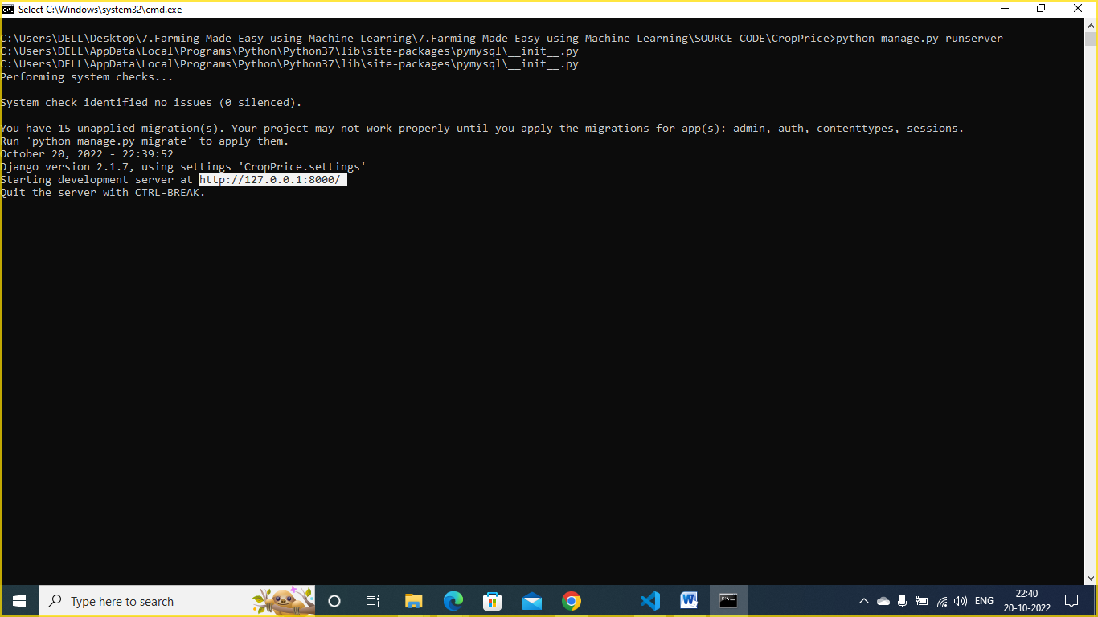
SCREENSHOTS
In above screen server started and now open browser and enter URL .

Slide 25
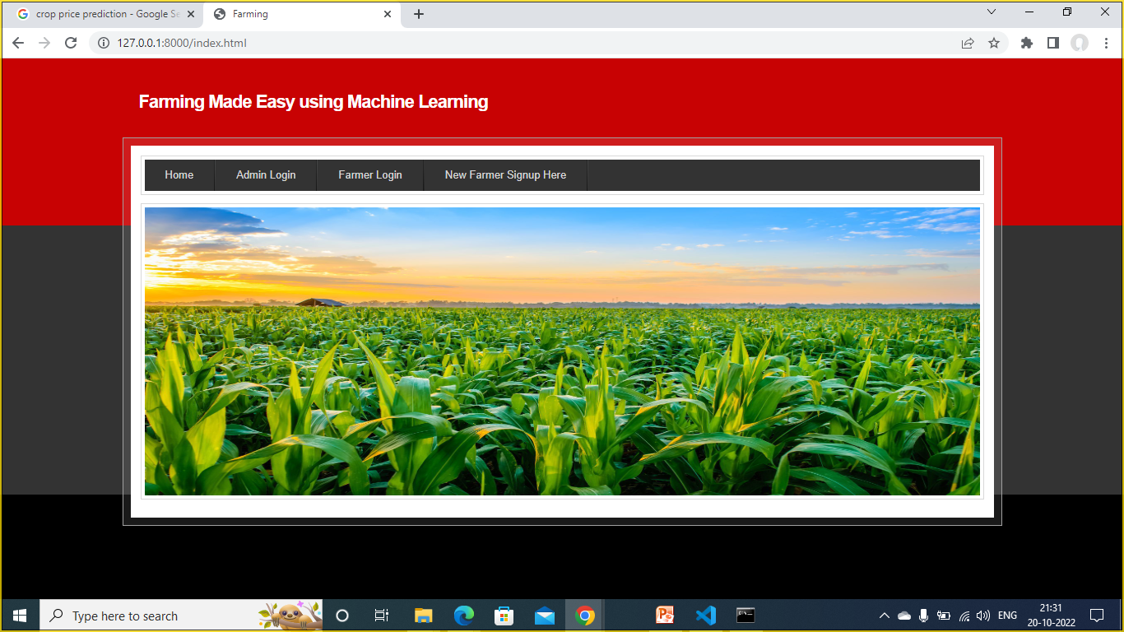
In above screen click on ‘Admin Login’ link to get below login screen.

Slide 26
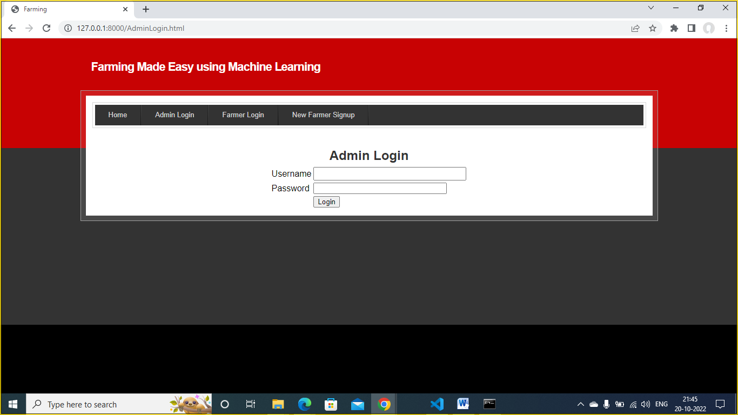
In above screen admin will login and after login we will get below screen.

Slide 27
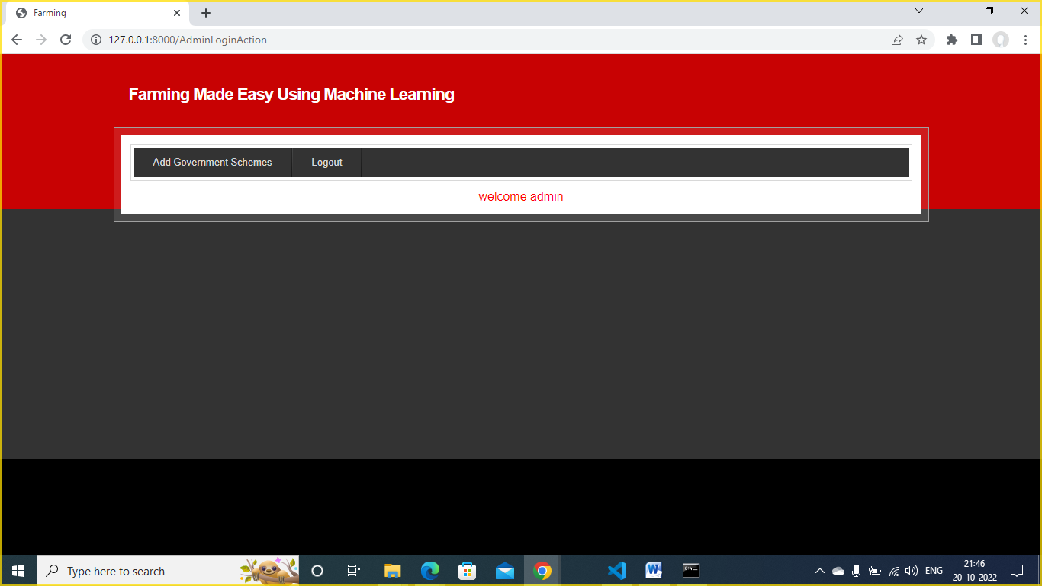
In above screen click on ‘Add Government Schemes’ option to add new schemes.

Slide 28
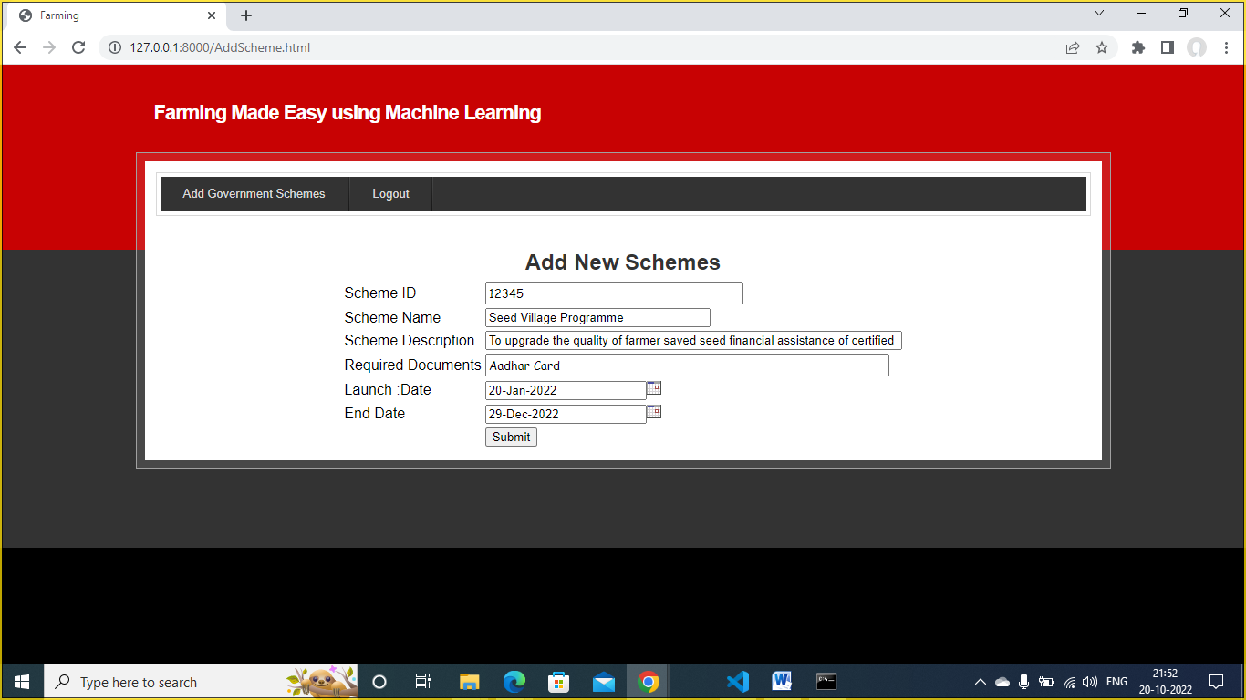
In above screen admin will add schemes details with start and end date and then click on ‘Submit’ button to save schemes details.

Slide 29
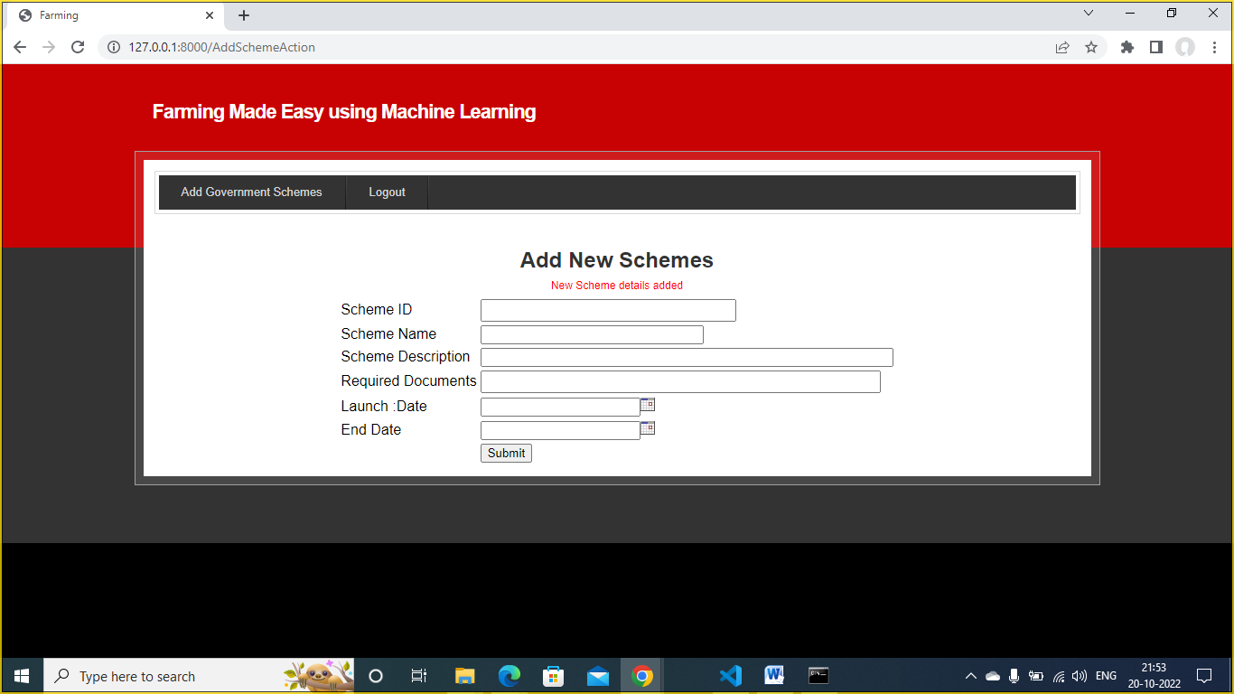
In above screen in red color text we can see scheme details added and after logout we can sign up to new farmer.

Slide 30
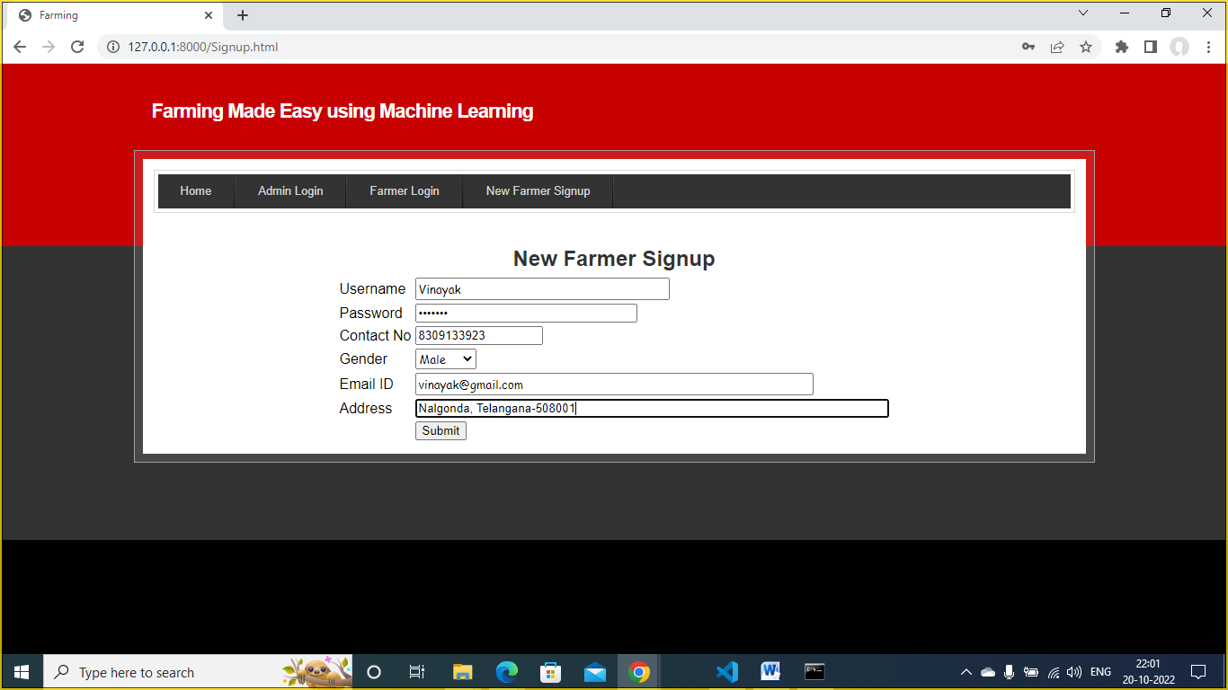
In above screen farmer is signing up and click on ‘Submit’ button to complete signup process.

Slide 31
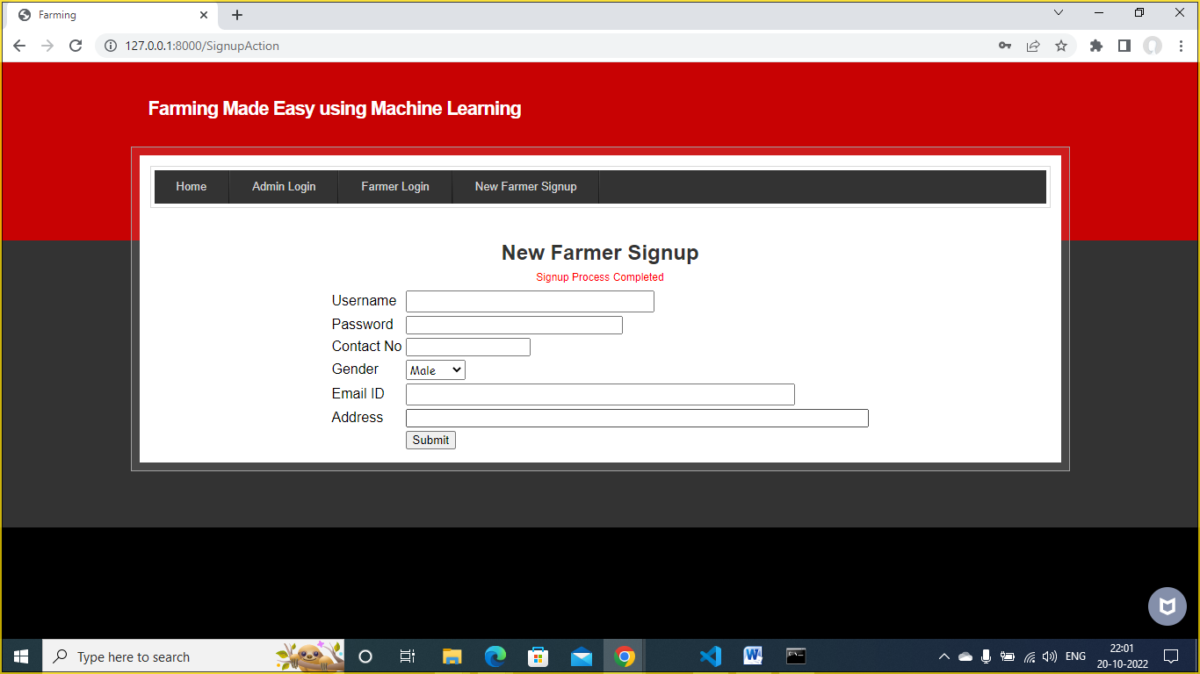
In above screen signup is completed and now click on ‘Farmer Login’ option to login to farmers account.

Slide 32
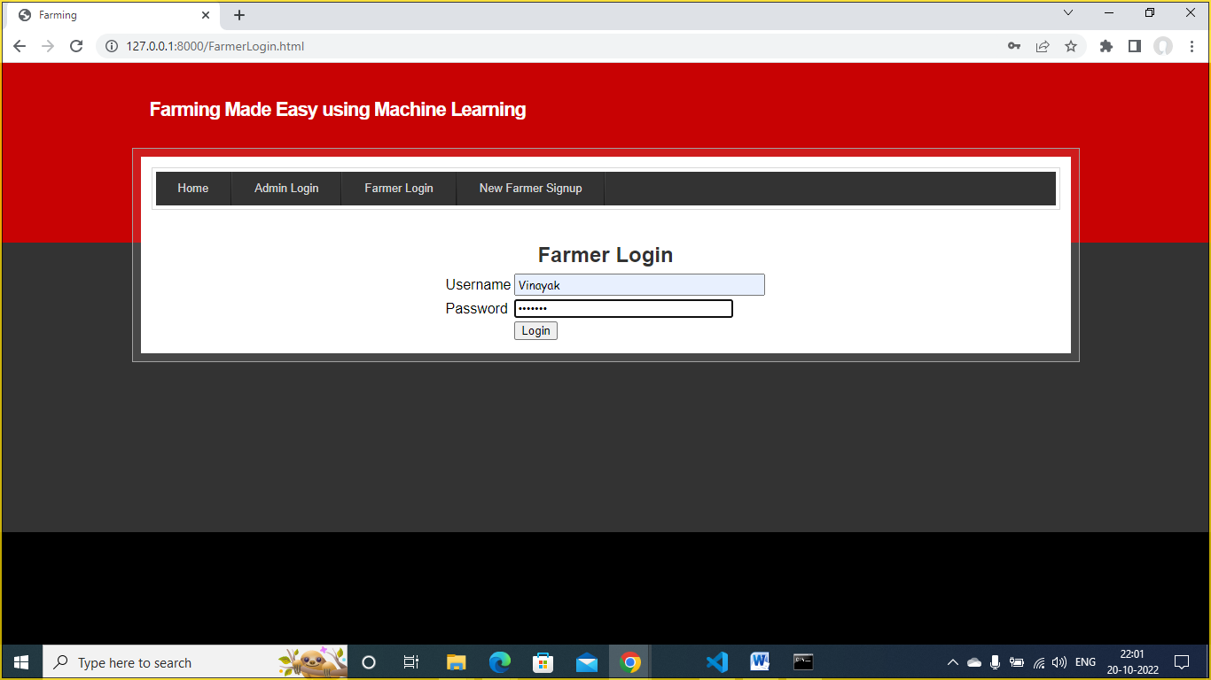
In above screen farmer is entering login credentials and click on ‘Login’ button to login.

Slide 33

In above screen farmer can click on ‘View Schemes’ option to get all schemes details.

Slide 34
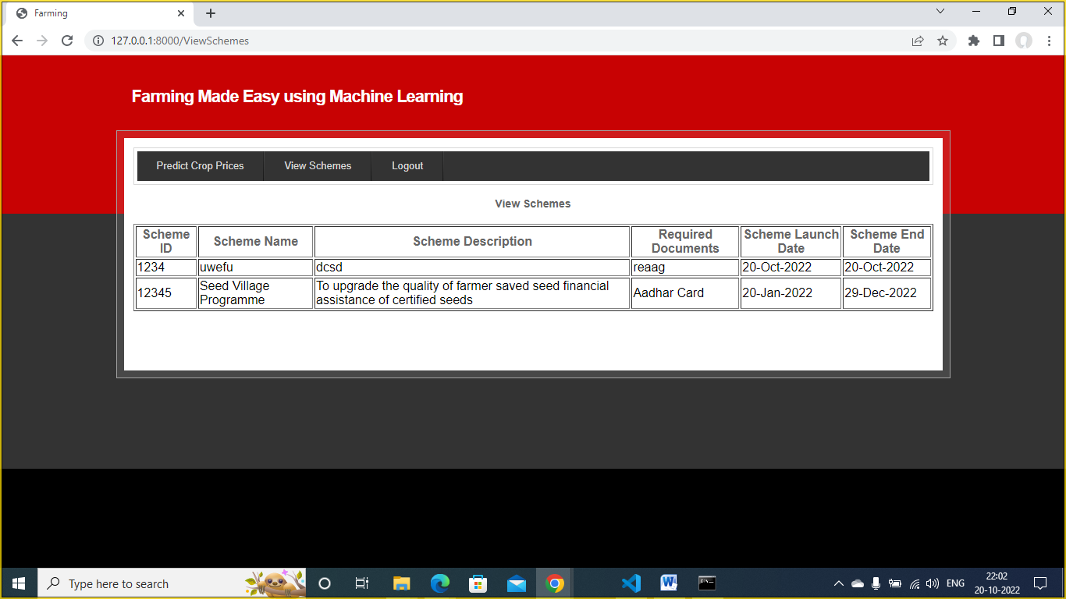
In above screen all schemes details can be viewed by farmer and now click on ‘Predict Crop Prices’ option to get below screen.

Slide 35
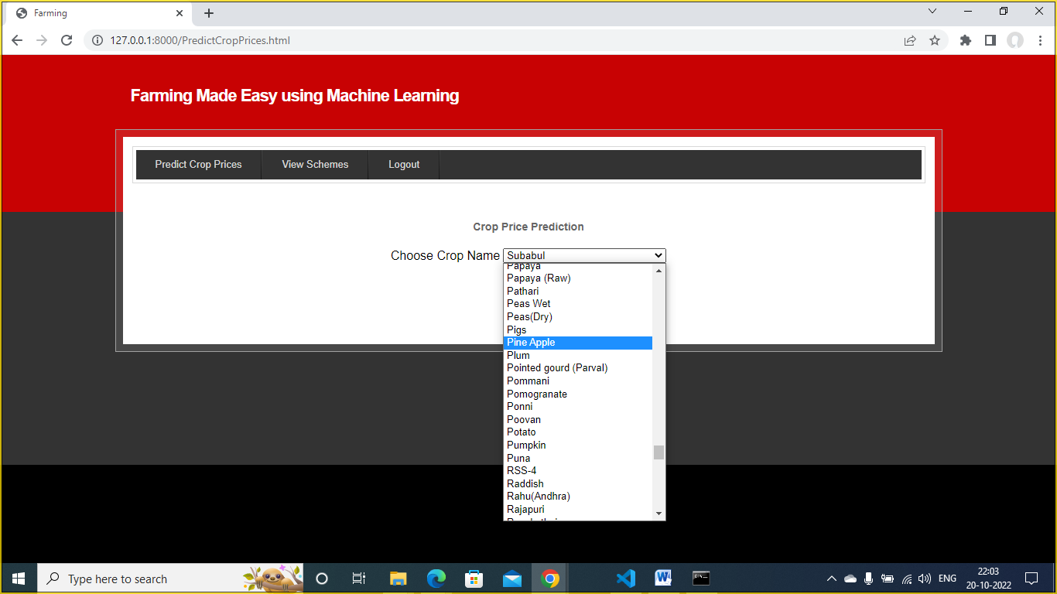
TEST CASES
In above screen farmer can select desired crop and then click on 'Predict Crop Prices' options to get below prediction.

Slide 36
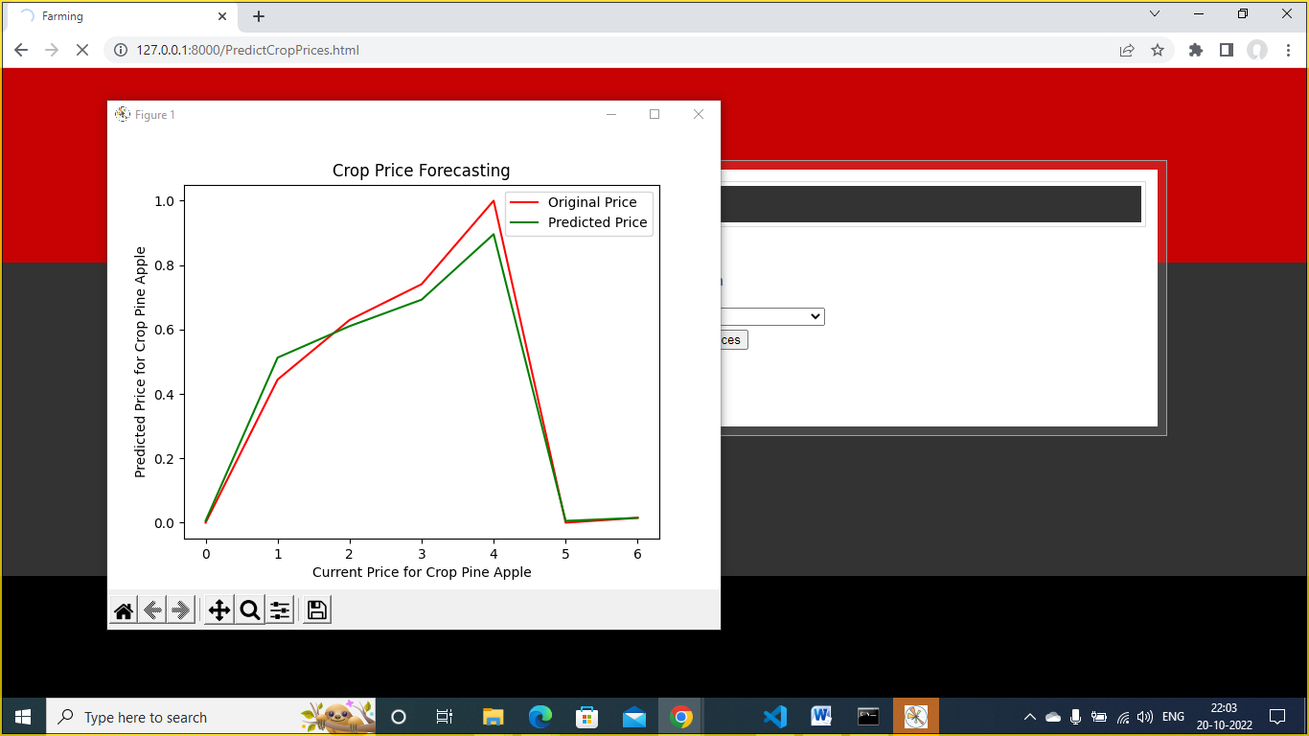
In above graph red line represents original prices and green line represents predicted prices and by seeing above graph farmer can understand what is current price and what will be future price and now close above graph to view predicted values.

Slide 37
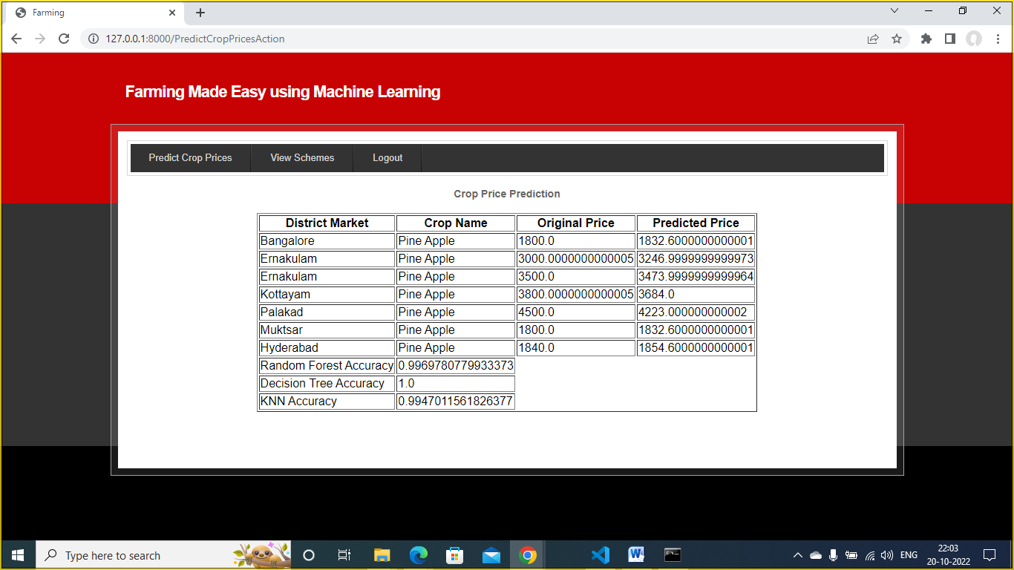
RESULTS
In above screen first column represents ‘District Market’ and second column represents ‘Crop Name’ and third column represents ‘Original Crop Price’ and fourth column represents “predicted prices’ using Machine learning algorithm.
In last 3 lines we can see Random Forest, KNN, Decision Tree prediction accuracy.
Similarly you can select any crop and get prediction prices.

Slide 38
CONCLUSION
This project is undertaken using machine learning and evaluates the performance by using KNN , Random Forest and Decision Tree algorithms. In our proposed model among all the three algorithm Decision Tree gives the better yield prediction as compared to other algorithms .
As most extreme sorts of harvests will be secured under this system, farmers may become more acquainted with the yield which may never have been developed. The work exhibited the expected utilization of machine learning methods in foreseeing the harvest cost dependent on the given attributes. The created web application is easy to understand and the testing accuracy is over 90%.

Slide 39
FUTURE ENHANCEMENTS
This system can be enhanced by building a model with an increase in the number of crops. We can extend our research by including chat portal which will also be useful for the farmers to communicate with each other from different areas and know the price of the crop for which they are selling.
Fertilizer recommendation helps to increase the crop yield further.
Using Soil pH value we can recommend suitable crop to be planted.
Seasons, Humidity and Temperature can also be helpful for growth of more efficient crops.

Slide 40
REFERENCES
[1] Rachana, Rashmi, Shravani, Shruthi, Seema Kousar, Crop Price Forecasting System Using Supervised Machine Learning Algorithms, International Research Journal of Engineering and Technology (IRJET), Apr 2019
[2] Nishiba Kabeer, Dr.Loganathan.D, Cowsalya.T, Prediction of Crop Yield Using Data Mining, International Journal of Computer Science and Network, June 2019
[3] J. Vijayalakshmi, K. PandiMeena, Agriculture TalkBot Using AI, International Journal of Recent Technology and Engineering (IJRTE), July 2019
[4] Gamage, A., & Kasthurirathna, D. Agro-Genius: Crop Prediction Using Machine Learning, International Journal of Innovative Science and Research Technology, Volume 4, Issue 10, October – 2019
[5] Vohra Aman, Nitin Pandey, and S. K. Khatri. "Decision Making Support System for Prediction of Prices in Agricultural Commodity." 2019 Amity International Conference on Artificial Intelligence (AICAI). IEEE, 2019.

Slide 41
[6] Nguyen, Huy Vuong, et al. "A smart system for short-term price prediction using time series models." Computers & Electrical Engineering 76 (2019).
[7] Sangeeta, Shruthi G, Design And Implementation Of Crop Yield Prediction Model In Agriculture, International Journal Of Scientific & Technology Research Volume 8, Issue 01, January 2020.
[8] Rohith R, Vishnu R, Kishore A, Deeban Chakkarawarthi, Crop Price Prediction and Forecasting System using Supervised Machine Learning Algorithms, International Journal of Advanced Research in Computer and Communication Engineering, March 2020 .
[9] Naveen Kumar P R, Manikanta K B, Venkatesh B Y, Naveen Kumar R, Amith Mali Patil, Journal of Xi'an University of Architecture & Technology, 2020.
[10] Kumar, Y. Jeevan Nagendra, et al. "Supervised Machine learning Approach for Crop Yield Prediction in the Agriculture Sector." 2020 5th International Conference on Communication and Electronics Systems (ICCES). IEEE, 2020.

